Slide 1
Movies: An analysis of Quality over Time

Slide 2

Introduction
The following analysis reviews IMDb movie ratings over time in the United States from 1915-2023. In a country dominated by commerce and profitability, we asked: Is there evidence to suggest that the volume of released movies has increased over the years due to the pursuit of profit, potentially leading to a sacrifice in the overall quality of movies? To begin, we started with the following questions.
Is there an overall increase in volume of movies over time?
Is there an increase in Gross Revenue over time?
Is the overall quality of movies decreasing over time?
Notes:
MS

Slide 3
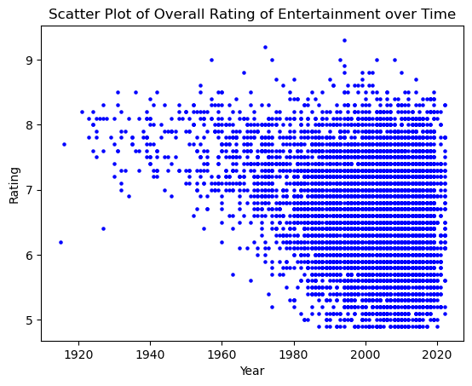
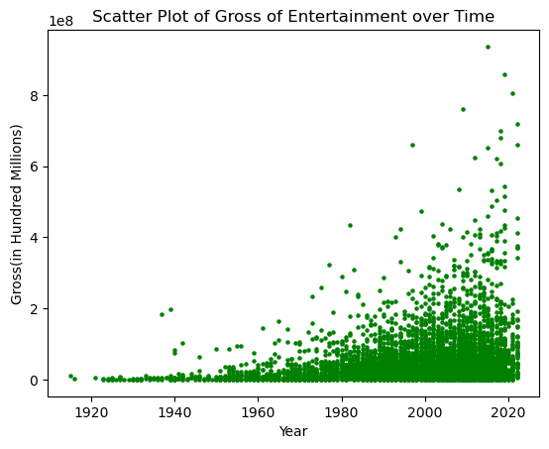
Overall Rating & Gross over Time
The data set includes a total of 7,085 movies as seen plotted in the Overall Rating of Entertainment over Time. Ratings are highly varied, yet we can see a notable amount of positive reception through the years. However, we can also note a substantial increase in lower ratings as the years progress. Regardless, the following plot also shows significant increases in gross, with peaks occurring in the more recent years.
Notes:
MS
Extra points: started with 10k movies, ended with 7k after clean up

Slide 4
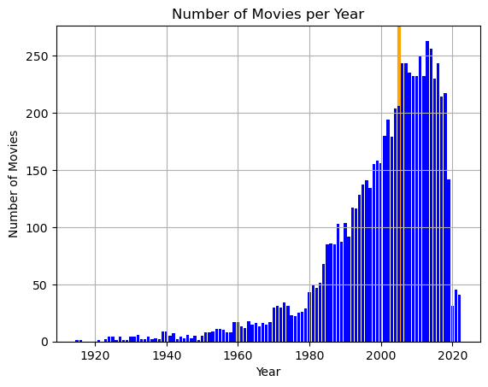
Yearly Data: Movies
In Question 1 we asked: Is there an overall increase in volume of movies over time? Based on the bar graph which provides a clear yearly view, data skews heavily to the right. This confirms movies have increased in recent years.
Findings are further backed by analyzing the mean, which lands in 2005. With this we see it took 90 years for the first half of the movies to be made, and only 18 years to complete the second half of movies in this data set.
Notes:
MS

Slide 5
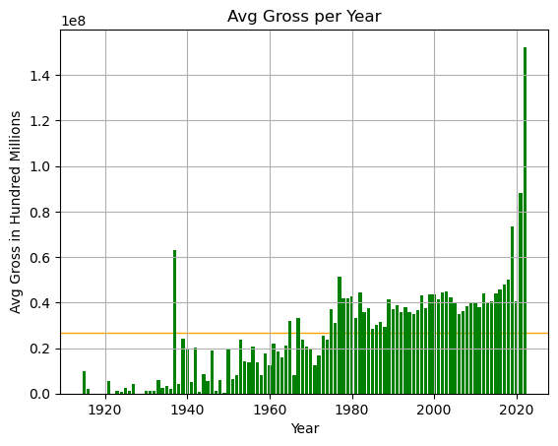
Yearly Data: Gross
Next, Question 2 reviews Gross- Is there an increase over time? As noted in our initial findings, this scatter plots shows a positive correlation between Time and Gross with highest peaks in the last decade.
Based on the additional graph, the average gross (in Hundred Millions) is 0.27. This highlights all movies after 1974 grossed above the mean (with a maximum of $936,660,000) while most years prior to 1974 fall below, with the exception of a few outliers.
Notes:
MU

Slide 6
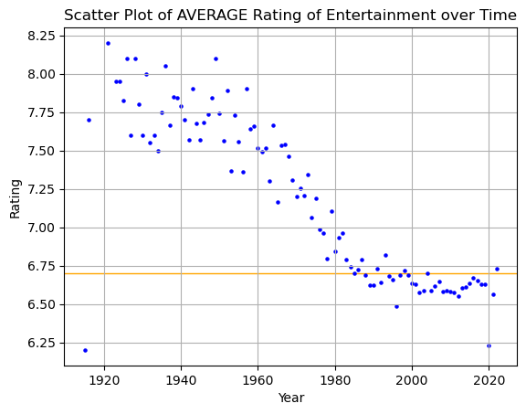
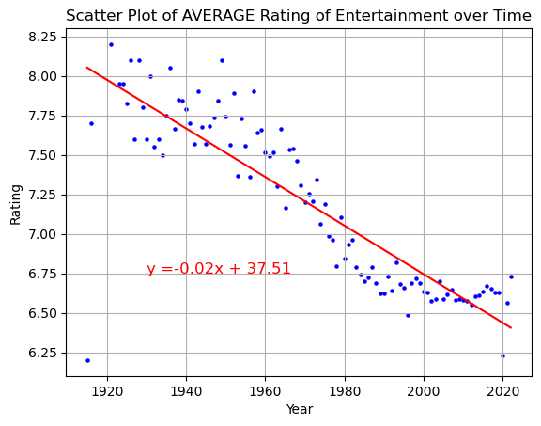
Average Ratings
Finally, Question 3 inspects whether the overall quality of movies is decreasing over time. Based on the scatter plot, we can confirm a negative correlation between time and ratings as all movies before 1980 are well above the mean. Conversely, most movies after 1980 are at or below the average.
Average rating: 6.70
In a linear regression analysis, the r value indicates a significant negative correlation between the average rating and the year of release, and a small p value solidifies the decrease in quality of movies over time within our dataset.
An r value of -0.867
A p value of 2.72e-32
Notes:
MU

Slide 7
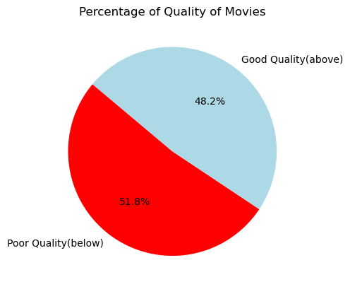
Overall Quality
Movies were split into 2 categories based on the average rating.
Movies rated higher than the mean were dubbed “Good Quality”, while
Movies rated lower than the mean were dubbed “Poor Quality”.
Pie Chart shows a greater percentage of Poor Quality rated movies overall by 3.6%.
Notes:
YC

Slide 8
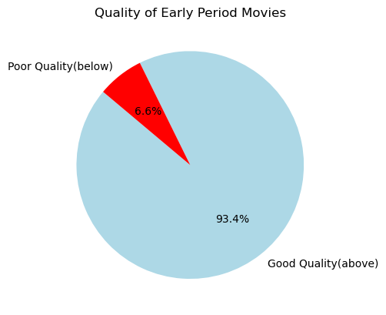
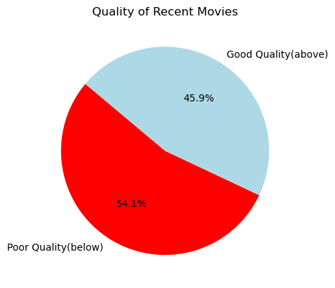
Time Period Comparison
With the data split so closely, we took a deeper dive into quality based on the midpoint in 1969.
In the Early Period, we see that a majority of movies (93.4%) were of “Good Quality”( above 6.70 on IMDB Rating)
Comparatively, we see a majority of movies (54.1%) were of “Poor Quality”(Below 6.70 on IMDB Rating) from 1970 and on. This further confirms Question 3.
Notes:
YC

Slide 9

Conclusion
Over the years, the movie industry has had a significant rise in the number of movies produced annually. With the rising number of movies, the average ratings of these films have a downward trend, suggesting while more movies are being made, many are failing to meet the quality standards set by previous films.
Additionally, the analysis of gross earnings per year reinforces the suggestion that financial success is prioritized over quality.
Notes:
DG

Slide 10
Limitations and Follow Ups
Some limitations include:
Economic conditions
Cultural and societal factors
Technological advancements
Sample size
Further questions to consider:
How has inflation affected movie profits?
What effects has technology had on the speed of movies created?
Does the sample size provide bias?

Slide 11
CODING REVIEW
Notes:
DG

